Slide 1

Apache Cassandra A Highly Scalable NoSQL Database
Presented by…
Ramesh Mannava
Nanda Kishore Tokala

Slide 2
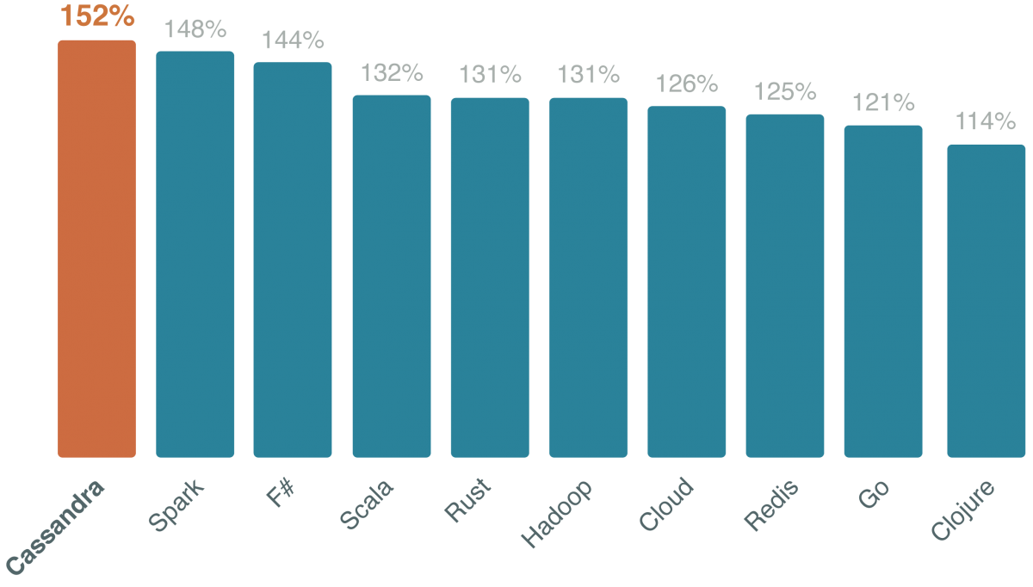
Developers who use Apache Cassandra earn the top tech salary.
☺ ☺ ☺

Slide 3
What is NoSQL?
Many of today’s online applications have database requirements that exceed the capabilities of legacy relational databases.
The need for
Very low latency
Unknown levels of scale
Continuous uptime
Global distribution of data
The ability both write and read data anywhere
Reducing both software and operational costs

Slide 4
What is NoSQL? (cont..)
Non-relational databases use new and potentially unfamiliar architectures and data models.
To satisfy the requirements of modern online applications, these new databases must make trade-offs as dictated by the CAP theorem.
These trade-offs have far-reaching consequences, among them a sacrifice of traditional relational database features like automatic table joins and ACID transactions.
In the majority of cases, these trade-offs are well worth it.

Slide 5
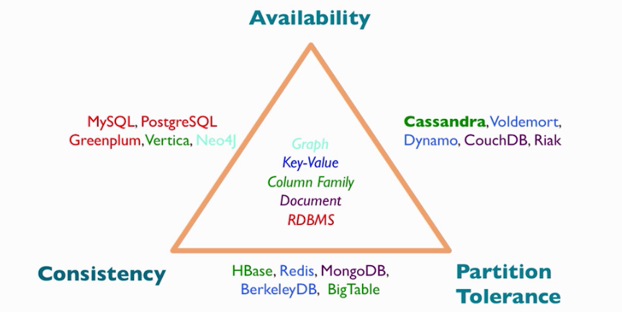
CAP Theorem
In distributed systems, consistency, availability, and partition tolerance exists in a mutually dependent relationship. Pick any two.

Slide 6
NoSQL Databases
Column Store : Hbase, Cassandra, Amazon SimpleDB etc.
Document Store : MongoDB, CouchDB etc.
Key-Value : DynamoDB, Redis etc.
Graph : Neo4j, TITAN etc.
Multi-model : FatDB, OrientDB etc.
Object : db4o, Versant etc.
Grid & Cloud : GigaSpaces, Oracle Coherence etc.
XML : eXist, BaseX etc.
Multi dimensional : SciDB, DaggerDB etc.
Multi value : U2, Reality etc.
Network Model : Vyhodb
Event Sourcing : EventStore
Other : IBM Lotus, ISIS Family etc.

Slide 7
What is Apache Cassandra?
Apache Cassandra is a massively scalable open source non-relational database that offers:
Continuous availability
Linear scale performance
Operational simplicity
Easy data distribution across multiple data centers and cloud availability zones.

Slide 8
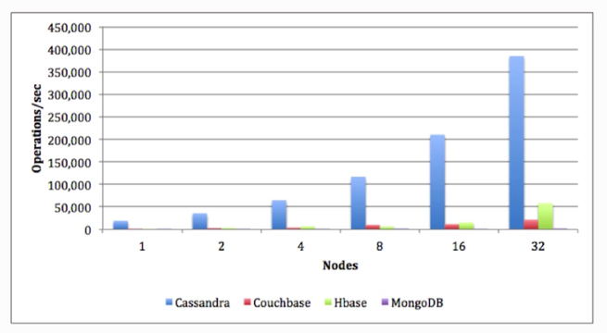
What is Apache Cassandra?(cont..)
Cassandra was originally developed at Facebook, was open sourced in 2008, and became a top-level Apache project in 2010.

Slide 9
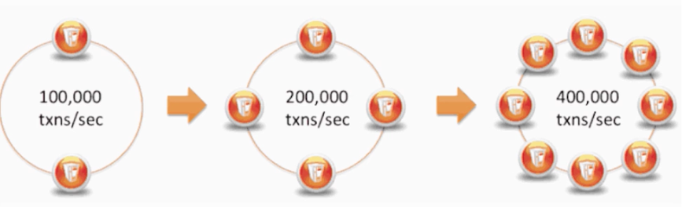
What is Apache Cassandra?(cont..)
No single point of failure, due to horizontal scaling
Horizontal scaling: add commodity hardware to a cluster
Vertical scaling: add RAM and CPUs to a specialized high performance box

Slide 10
How Does Cassandra Differ From a Relational Database?
Relational Database | Cassandra
Handles moderate incoming data velocity | Handles high incoming data velocity
Data arriving from one/few locations | Data arriving from many locations
Manages primarily structured data | Manages all types of data
Supports complex/nested transactions | Supports simple transactions
Single points of failure with failover | No single points of failure; constant uptime
Supports moderate data volumes | Supports very high data volumes
Centralized deployments | Decentralized deployments
Data written in mostly one location | Data written in many locations
Supports read scalability (with consistency sacrifices) | Supports read and write scalability
Deployed in vertical scale up fashion | Deployed in horizontal scale out fashion

Slide 11
How has Cassandra evolved?
Core technologies:
Google BigTable: Foundation of the storage model
Amazon dynamo: Foundation of the distribution backbone
Facebook: Integrated BigTable and Dynamo, then relaesed as Cassandra
Rapid evolution:
0.6 – April 2010
0.7 – January 2011
0.8 – June2011
1.0 – October 2011
1.1 – April 2012
1.2 – January 2013
2.0 – September 2013
2.1 – September 2014
Top level apache product since 2010

Slide 12
Key Cassandra Features and Benefits
Cassandra provides a number of key features and benefits for those looking to use it as the underlying database for modern online applications:
Massively scalable architecture – a master less design where all nodes are the same, which provides operational simplicity and easy scale-out.
Active everywhere design – all nodes may be written to and read from.
Linear scale performance – the ability to add nodes without going down produces predictable increases in performance.
Continuous availability – offers redundancy of both data and node function, which eliminate single points of failure and provide constant uptime.

Slide 13
Key Cassandra Features and Benefits (cont..)
Transparent fault detection and recovery – nodes that fail can easily be restored or replaced.
Flexible and dynamic data model – supports modern data types with fast writes and reads.
Strong data protection – a commit log design ensures no data loss and built in security with backup/restore keeps data protected and safe.
Tunable data consistency – support for strong or eventual data consistency across a widely distributed cluster.
Multi-data center replication – cross data center (in multiple geographies) and multi-cloud availability zone support for writes/reads.
Data compression – data compressed up to 80% without performance overhead.
CQL (Cassandra Query Language) – an SQL-like language that makes moving from a relational database very easy.

Slide 14
What are common Cassandra usecases?
Cassandra is particularly useful for
Playlist and selection (such as Spotify)
Personalization and recommendation engines (such as Ebay)
Messaging (such as Instagram)
Fraud detection (such as Barracuda)
Sensor data (such as Zonar)
Many, many functional and industrial use cases are available
http://planetcassandra.org/functional-use-cases/

Slide 15

Who is using Cassandra?

Slide 16

Architecture Overview
Cassandra’s architecture is responsible for its ability to scale, perform, and offer continuous uptime.
Rather than using a legacy master-slave or a manual and difficult-to-maintain sharded design, Cassandra has a masterless “ring” architecture that is elegant, easy to set up, and easy to maintain.

Slide 17
Architecture Overview (cont..)
In Cassandra, all nodes play an identical role; there is no concept of a master node, with all nodes communicating with each other via a distributed, scalable protocol called “gossip”.
To add more capacity, you simply add new nodes to an existing cluster without having to take it down first.
Cassandra’s architecture also means that, unlike other master-slave or sharded systems, it has no single point of failure and therefore is capable of offering true continuous availability and uptime.

Slide 18
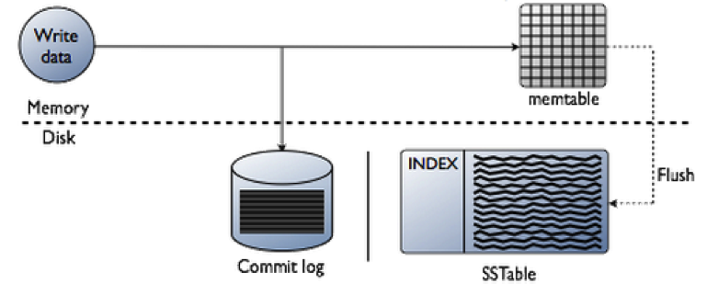
Writing Data

Slide 19
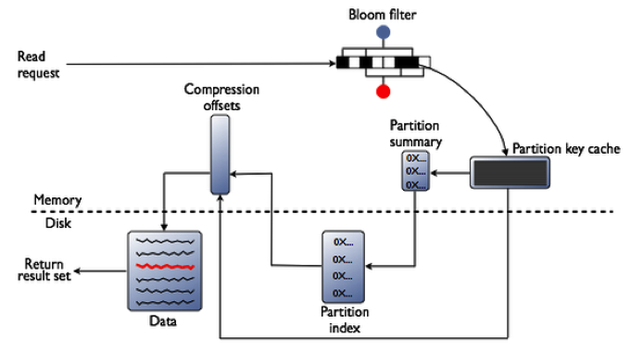
Reading Data

Slide 20
Automatic Data Distribution
Cassandra has an internal component called a partitioner, which determines how data is distributed across the nodes that make up a database cluster.
In short, a partitioner is a hashing mechanism that takes a table row’s primary key, computes a numerical token for it, and then assigns it to one of the nodes in a cluster.
While the partitioner is a configurable property of a Cassandra cluster, the default partitioner is one that randomizes data across a cluster and ensures an even distribution of all data.
Cassandra also automatically maintains the balance of data across a cluster even when existing nodes are removed or new nodes are added to a system.

Slide 21
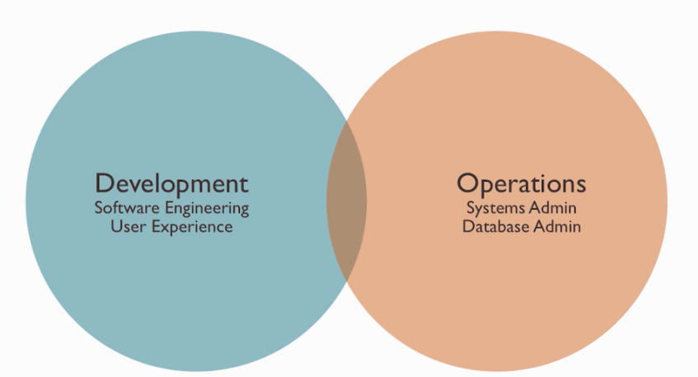
What does “DevOps” mean?

Slide 22
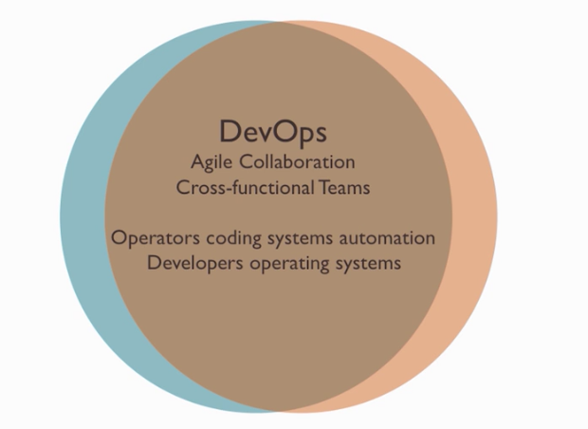
What does “DevOps” mean?(cont..)

Slide 23
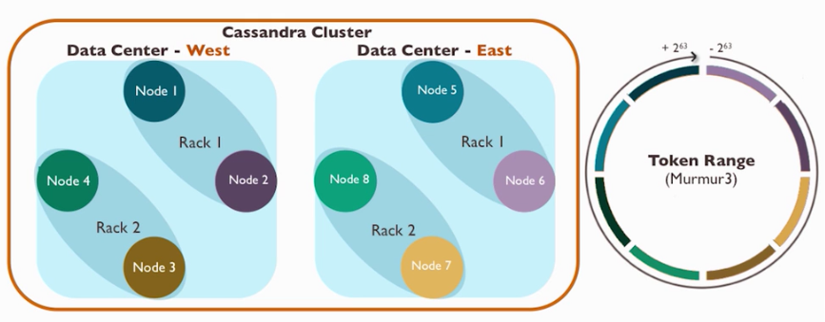
What is a cluster?
A peer to peer set of nodes
Node – one cassandra instance
Rack – a logical set of nodes
Data center – a logical set of racks
Cluster – The full set of nodes which map to a single complete token ring

Slide 24
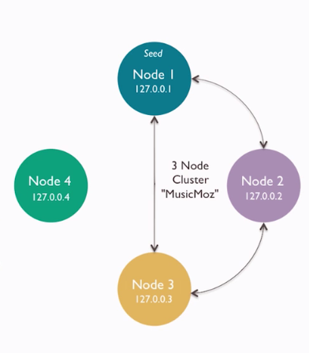
What is a cluster? (cont..)
Nodes join a cluster based on the configuration of their own conf/cassandra.yaml file.
Key settings include
Cluster name: shared name to logically distinguish a set of nodes
Seed: IP addresses of initial nodes for a new node to contact and discover the cluster topology
Listen address: IP addresses through which this particular node communicates

Slide 25
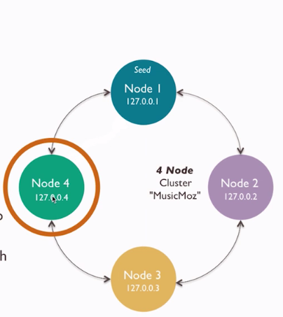

What is a cluster? (cont..)
Nodes join a cluster based on the configuration of their own conf/cassandra.yaml file.
Key settings include
Cluster name: shared name to logically distinguish a set of nodes
Seed: IP addresses of initial nodes for a new node to contact and discover the cluster topology
Listen address: IP addresses through which this particular node communicates

Slide 26
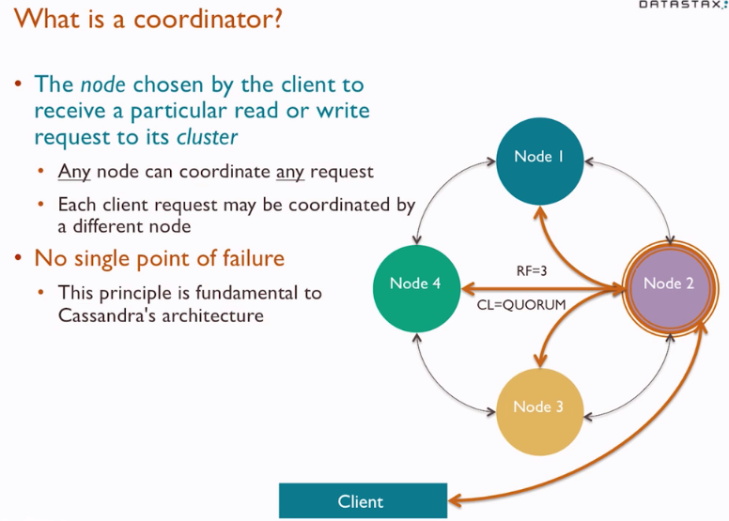
What is a coordinator?
The node chosen by the client to receive a particular read or write request to its cluster.
Any node can coordinate any request.
Each client request may be coordinated by a different node.
No single point of failure
This principle is fundamental to cassandra’s architecture

Slide 27
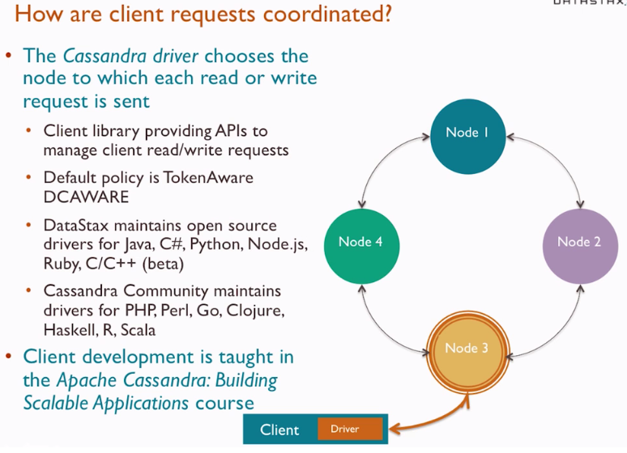
How are client requests coordinated?
The Cassandra driver chooses the node to which each read or write request is sent
Client library providing APIs to manage client read/write requests
Default policy is TokenAware DCAWARE
DataStax maintains open source drivers for java, c#, python, node.js, ruby, c/c++
Cassandra community maintains drivers for PHP, Perl, Go, Clojure, Haskell, R, Scala
Client deveopment is thought in the Apache Cassandra: Building Scalable Application course

Slide 28
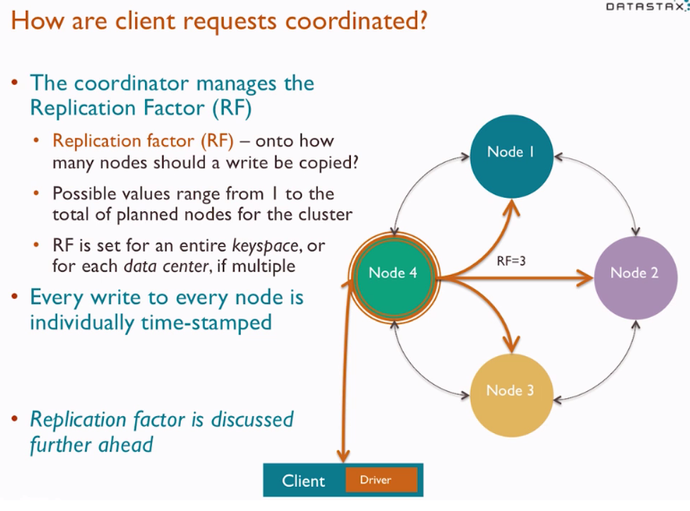
How are client requests coordinated? (cont..)
The coordinator manges the replication factor
Replication factor (RF): onto how nodes should a write be copied?
Possible values 1 to the total planned nodes for the cluster
RF is the set of entire keyspace, or for each data center, if mutliple
Every write to every node is individually time-stamped
Replication factor is discussed further ahead

Slide 29
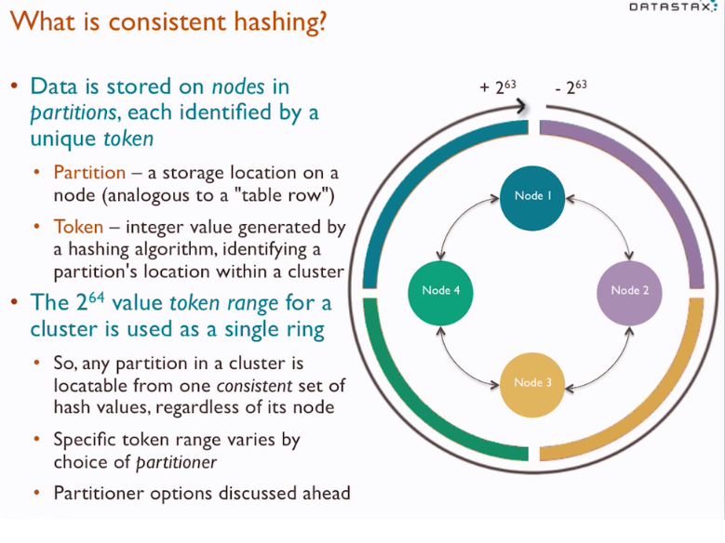
What is consistent hashing?
Data is stored on nodes in partitions, each identified by a unique token.
Partition: a storage on a node.
Token: integer value generated by a hashing algorithm, identifying a partition’s location within a cluster.
The 2⁶⁴ value token range for a cluster is used as a single ring .

Slide 30
Replication
Replication is configured at the keyspace level, allowing different keyspaces to have different replication models.
Cassandra is able to replicate data to multiple nodes in a cluster, which helps ensure reliability, continuous availability, and fast I/O operations.
The total number of data copies that are replicated is referred to as the replication factor.
Once a keyspace and its replication have been created, Cassandra automatically maintains that replication even when nodes are removed, added, or fail.

Slide 31
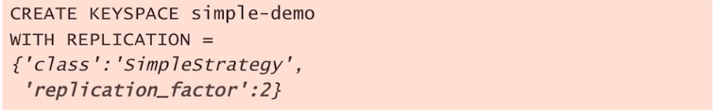
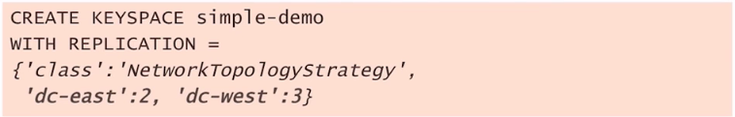
How does the keyspace imapact replication?
Replication factor is configured when a keyspace is created.
SimpleStrategy (learning use only) – one factor for entire cluster.
Assigned as “replication_factor”
NetworkTopologyStrategy – separate factor for each data center in cluster
assigned by data center id (as also used in cassandra-rackdc.properties)

Slide 32
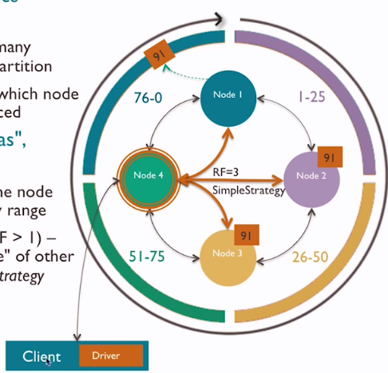
How does a coordinator forward write requests?
The target table’s keyspace
determines
Replication factor - how many replicas to make of each partition
Replication strategy – on which node each replica be placed
All partitions are “replicas”, there are no originals
First replica – placed on the node owning its tokens primary range
(Subsequent) replicas (if RF > 1) – placed in “secondary range” of other nodes, per the replication strategy

Slide 33
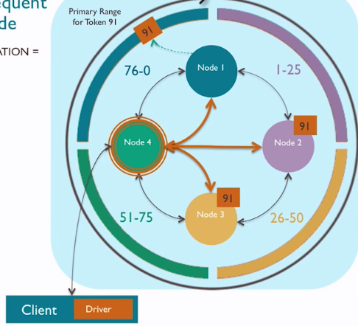
How does a coordinator forward write requests?
The target table’s keyspace
determines
Replication factor - how many replicas to make of each partition
Replication strategy – on which node each replica be placed
All partitions are “replicas”, there are no originals
First replica – placed on the node owning its tokens primary range
(Subsequent) replicas (if RF > 1) – placed in “secondary range” of other nodes, per the replication strategy

Slide 34
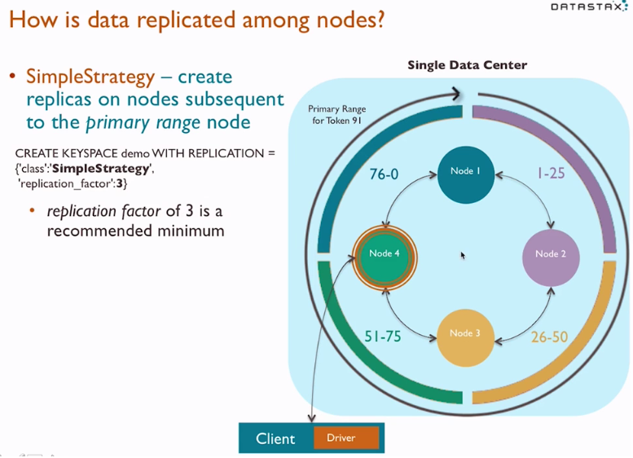
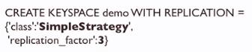
How is data replicated among nodes?
SimpleStrategy – create replicas on nodes subsequent to the primary range node
Replication factor of 3 is a recommended minimum

Slide 35
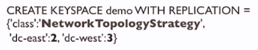
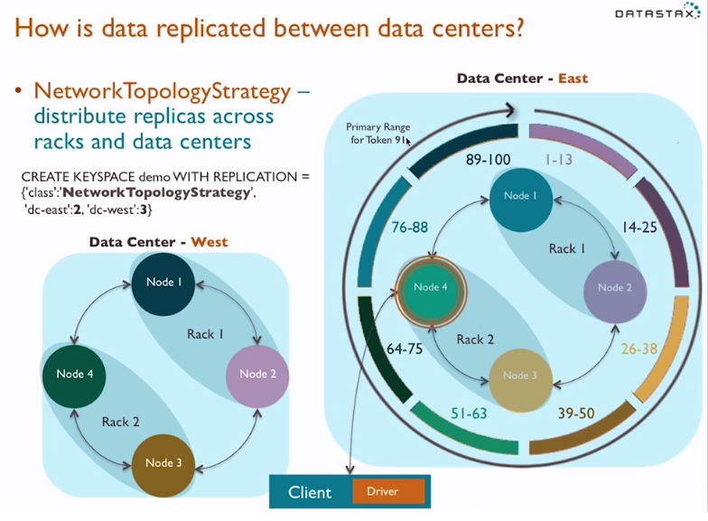
How is data replicated among nodes?(cont..)
NetworkTopologyStrategy – distribute replicas across racks and data centers

Slide 36
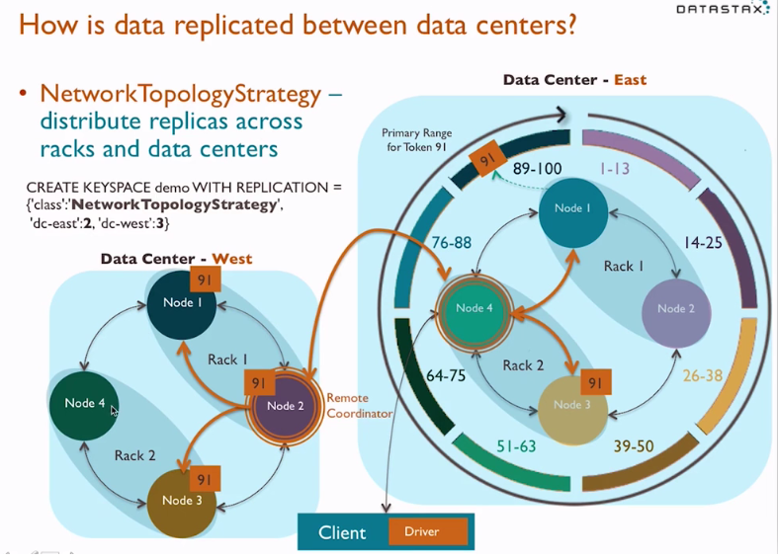
How is data replicated among nodes?(cont..)
NetworkTopologyStrategy – distribute replicas across racks and data centers

Slide 37
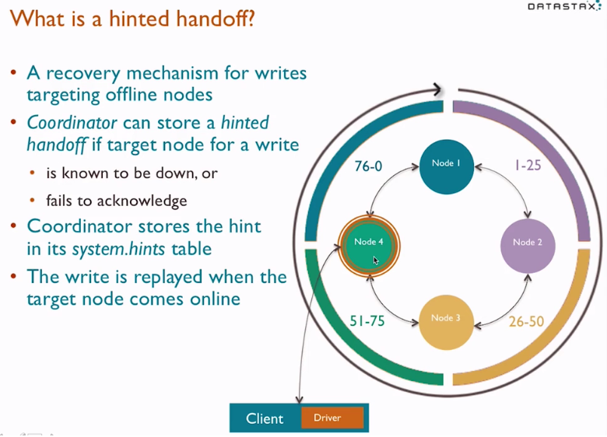
What is a hinted handoff?
A recovery mechanism for writes targeting offline nodes.
Coordinator can store a hinted handoff if target node for a write
Is known to be down, or
Fails to acknowledge
Coordinator stores the hint in its system.hints table
The write is replayed when the target node comes online

Slide 38
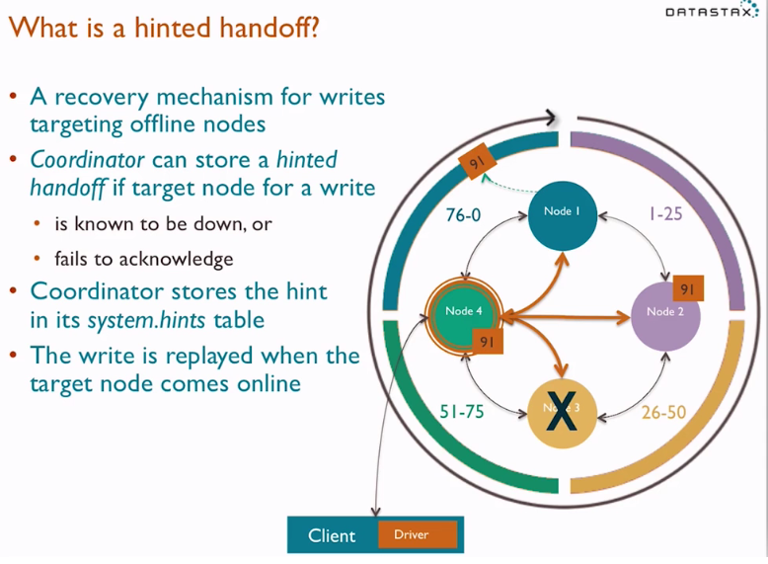
What is a hinted handoff?
A recovery mechanism for writes targeting offline nodes.
Coordinator can store a hinted handoff if target node for a write
Is known to be down, or
Fails to acknowledge
Coordinator stores the hint in its system.hints table
The write is replayed when the target node comes online

Slide 39
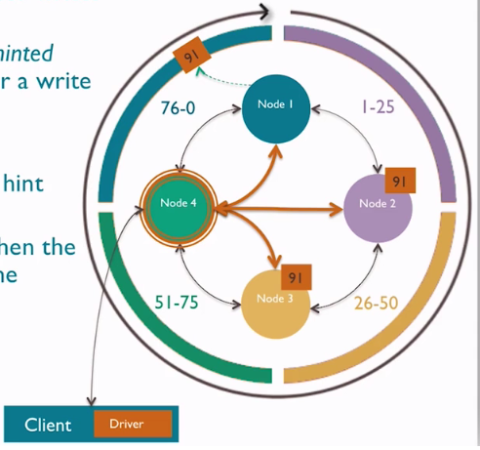
What is a hinted handoff?
A recovery mechanism for writes targeting offline nodes.
Coordinator can store a hinted handoff if target node for a write
Is known to be down, or
Fails to acknowledge
Coordinator stores the hint in its system.hints table
The write is replayed when the target node comes online

Slide 40
Transaction Management
While Cassandra does not support ACID transactions like most legacy relational databases, it does offer the “AID” portion of ACID.
The “C” of ACID—​consistency—​does not apply to Cassandra, as there is no concept of referential integrity or foreign keys.
Cassandra offers tunable data consistency across a database cluster.
Tunable data consistency is supported across single or multiple data centers.
Consistency is configurable on a per-query basis, meaning you can decide how strong or eventual consistency should be per SELECT, INSERT, UPDATE, and DELETE operation.
For example, if you need a particular transaction to be available on all nodes throughout the world, you can specify that all nodes must respond before a transaction is marked complete.

Slide 41
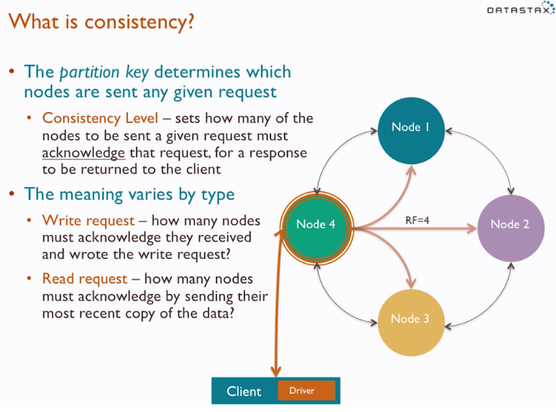
What is Consistency?
The partition key determines which nodes are sent any given request
Consistency Level – sets the how many of the nodes to be sent a given request must acknowledge that request , for a response to be returned to the client
The meaning varies by type
Write request – how many nodes must acknowledge they received and wrote the write request?
Read request – how many nodes must acknowledge by sending their most recent copy of the data?

Slide 42
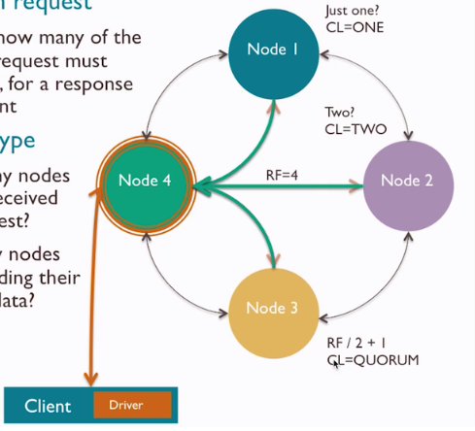
What is Consistency?
The partition key determines which nodes are sent any given request
Consistency Level – sets the how many of the nodes to be sent a given request must acknowledge that request , for a response to be returned to the client
The meaning varies by type
Write request – how many nodes must acknowledge they received and wrote the write request?
Read request – how many nodes must acknowledge by sending their most recent copy of the data?

Slide 43
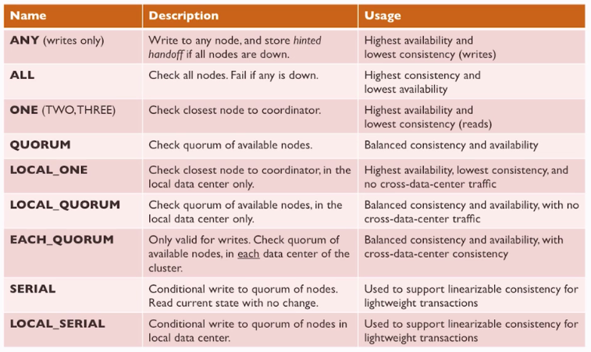
What consistency levels are available?

Slide 44
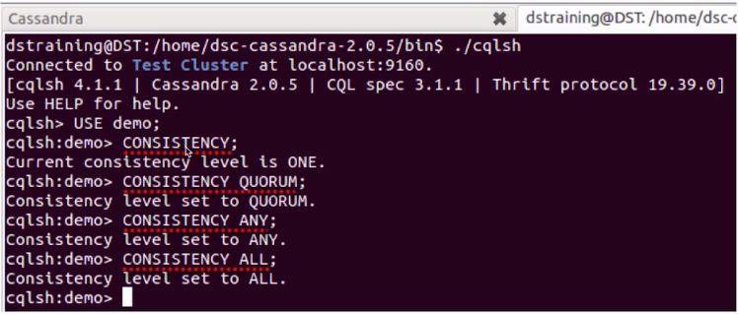
How do you set consistency for request?
The default consistency level for all requests is ONE
In cqlsh, the CONSISTENCY command modifies this value for all subsequent requests during the same cqlsh session
In client drivers, a ConsistencyLevel constant is passed as part of each request

Slide 45
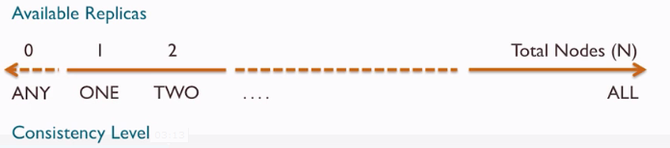
What is immediate vs. eventual consistency?
For give any read, how likely is it the data may be stale?
Immediate Consistency – reads always return the most recent data
Consistency level ALL guarantees immediate consistency, because all replica nodes are checked and compared before a result is returned
Highest latency because all replicas are checked and compared
Eventual Consistency – reads may return stale data
Consistency level ONE carries the highest risk of stale data, because only one replica node is checked before a result is returned
Lowest latency because the response from one replica is immediately returned

Slide 46
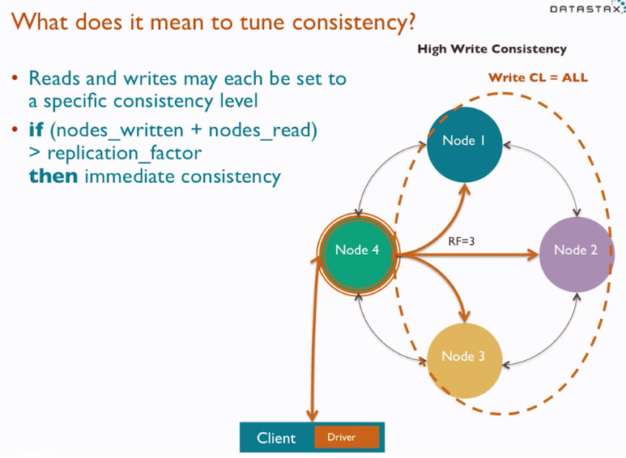
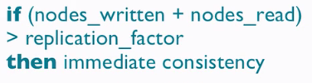
What does it mean to tune consistency?
Reads and writes may each be set to a specific consistency level

Slide 47
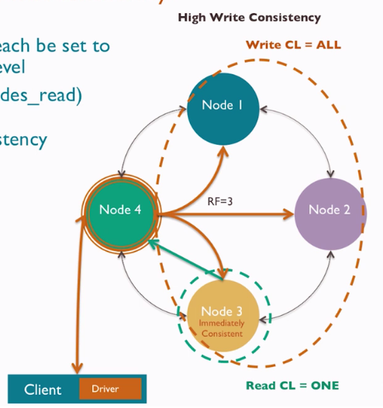
What does it mean to tune consistency?
Reads and writes may each be set to a specific consistency level

Slide 48
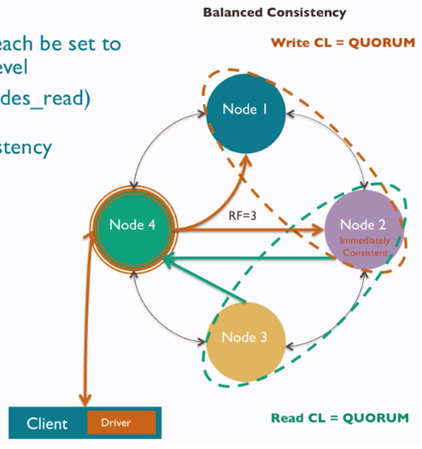
What does it mean to tune consistency?
Reads and writes may each be set to a specific consistency level

Slide 49
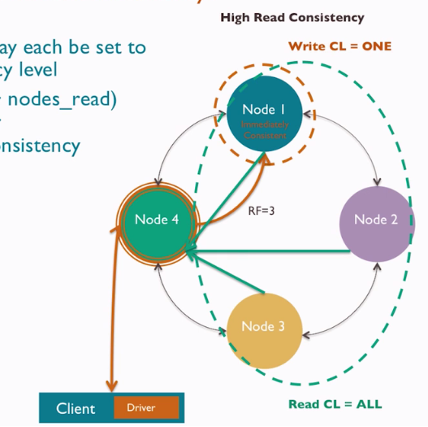
What does it mean to tune consistency?
Reads and writes may each be set to a specific consistency level

Slide 50
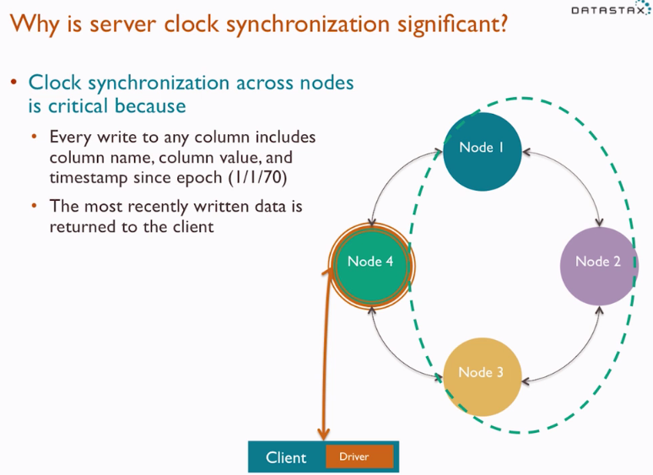
Why is server clock synchronization significant?
Clock synchronization across nodes is critical because
Every write to any column includes column name, column value, and timestamp since epoch(I/I/70)
The most recently written data is returned to the client

Slide 51
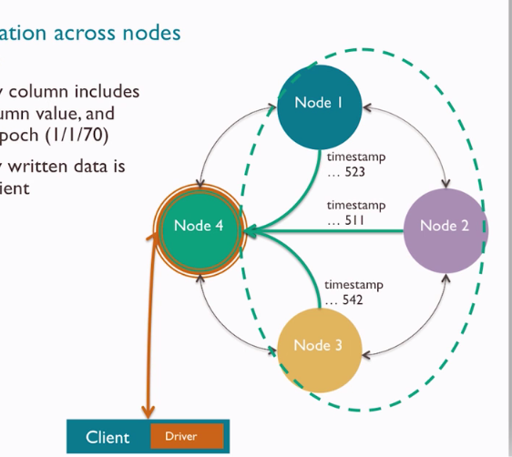
Why is server clock synchronization significant?
Clock synchronization across nodes is critical because
Every write to any column includes column name, column value, and timestamp since epoch(I/I/70)
The most recently written data is returned to the client

Slide 52
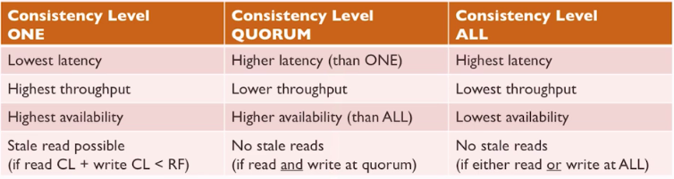
How do you choose a consistency level?
In any given scenario, is the value of immediate consistency worth the latency cost?
Netflix uses CL ONE and measures its “Eventual” consistency in milliseconds
Consistency level ONE is your friend …
If “stale” is measured in milliseconds, how much are those milliseconds worth?

Slide 53
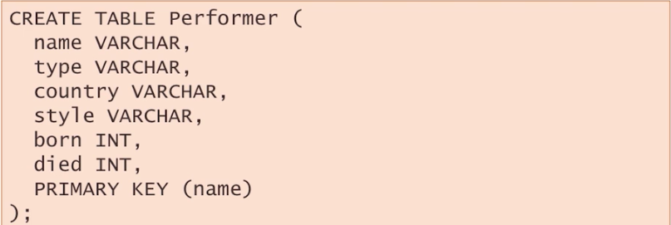
How does Cassandra model data?
Cassandra query language (CQL)
Provides a familiar, row-column, SQL-like approach
CREATE, ALTER, DROP
SELECT,INSERT, UPDATE, DELETE
Replaced the complex, storage oriented Thrift API used in prior versions.
Provides clear schema definitions in a flexible (NoSQL) schema context.

Slide 54
Cassandra Query Language
DDL (CREATE, ALTER, DROP), DML (INSERT, UPDATE, DELETE, TRUNCATE), and query (SELECT) operations are all supported.
CQL datatypes also reflect RDBMS syntax with numerical (int, bigint, decimal, etc.), character (ascii, varchar, etc.), date (timestamp, etc.), unstructured (blob, etc.), and specialized datatypes (set, list, map, etc.) being supported.
Various CQL command line utilities like CQLSH and graphical tools like DataStax DevCenter can be used to interact with a Cassandra cluster, and client drivers for Cassandra (Java, C#, etc.) also support CQL for developing applications.

Slide 55
Create Keyspace
cqlsh> CREATE KEYSPACE IF NOT EXISTS cycling WITH REPLICATION = { 'class' : 'NetworkTopologyStrategy', 'datacenter1' : 3 };
Use the keyspace:
cqlsh> USE cycling;

Slide 56
Types of primary keys
Simple Primary Key :
cqlsh> USE cycling;
CREATE TABLE cyclist_name ( id UUID, lastname text, firstname text, PRIMARY KEY (id));
Composite Partition Key:
cqlsh> CREATE TABLE rank_by_year_and_name ( race_year int, race_name text, cyclist_name text, rank int, PRIMARY KEY ((race_year, race_name), rank) );

Slide 57
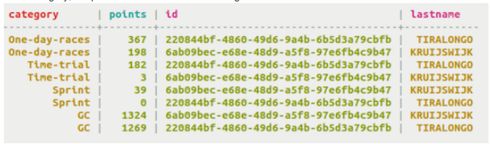
Compound Primary Key:
CREATE TABLE cyclist_category ( category text, points int, id UUID, lastname text, PRIMARY KEY (category, points) ) WITH CLUSTERING ORDER BY (points DESC);

Slide 58
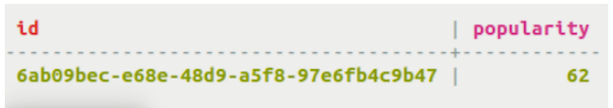
Counter Table
CREATE TABLE popular_count ( id UUID PRIMARY KEY, popularity counter );

Slide 59
CQL Statements
ALTER TABLE
CREATE TABLE
DELETE
INSERT
SELECT
TRUNCATE
UPDATE

Slide 60
Differences
No arbitrary WHERE clauses – In CQL your predicate can only contain columns specified in your primary key.
No JOIN construct – There is no way to join data across column families. Joining data between two column families is discouraged and thus there is no JOIN construct in CQL.
No GROUP BY – You cannot group identical data.
No arbitrary ORDER BY clauses – Order by can only be applied to a cluster column.

Slide 61
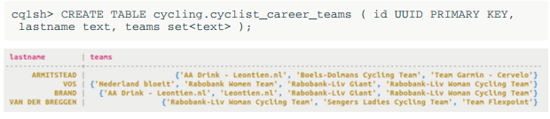
Collections
set :

Slide 62
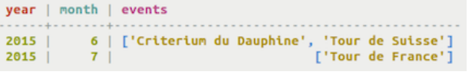
Collections:
List:
cqlsh> CREATE TABLE cycling.upcoming_calendar ( year int, month int, events list, PRIMARY KEY ( year, month) );

Slide 63
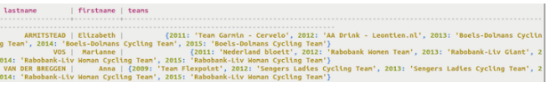
Collections
Map:
cqlsh> CREATE TABLE cycling.cyclist_teams ( id UUID PRIMARY KEY, lastname text, firstname text, teams map );

Slide 64
Tuples:
cqlsh> CREATE TABLE cycling.route (race_id int, race_name text, point_id int, lat_long tuple>, PRIMARY KEY (race_id, point_id));
UDT:
cqlsh> CREATE TYPE cycling.basic_info ( birthday timestamp, nationality text, weight text, height text );

Slide 65
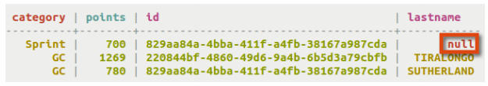
Inserting Json data
cqlsh> INSERT INTO cycling.cyclist_category JSON '{ "category" : "GC", "points" : 780, "id" : "829aa84a-4bba-411f-a4fb-38167a987cda", "lastname" : "SUTHERLAND“ }';
cqlsh> INSERT INTO cycling.cyclist_category JSON '{ "category" : "Sprint", "points" : 700, "id" : "829aa84a-4bba-411f-a4fb-38167a987cda" }';

Slide 66
Migrating Data to Cassandra
Moving data from an RDBMS or other database to Cassandra is fairly easy depending on the state of the existing data.
COPY command – The CQLSH utility provides a copy command that is able to load data from an operating system file into a Cassandra table. Note that this is not recommended for very large files.
SSTable loader – this utility is designed for more quickly loading a Cassandra table with a file that is delimited in some way (e.g. comma, tab, etc).
Sqoop – Sqoop is a utility used in Hadoop to load data from relational databases into a Hadoop cluster.

Slide 67
Migrating Data to Cassandra(cont..)
DataStax supports pipelining data from a relational databases table directly into a Cassandra table in its production certified Cassandra platform (DataStax Enterprise).
ETL tools – there are a variety of ETL tools that support Cassandra as both a source and target data platform.
Many of these tools not only extract and load data but also provide transformation routines that can manipulate the incoming data in many ways.
A number of these tools are also free to use (e.g. Pentaho, Jaspersoft, Talend).

Slide 68
Security
Cassandra defaults to having no security enabled.
We can enable security and create standard login accounts with passwords, and handle operational and data permission management via the familiar GRANT/REVOKE method of assigning and removing permissions.
Cassandra also provides encryption.
Advanced security is available in DataStax Enterprise and includes external authentication capabilities (e.g. Kerberos).

Slide 69


